Slide 1
KING COUNTY HOUSE PRICING
By Ulku Guneysu

Slide 2
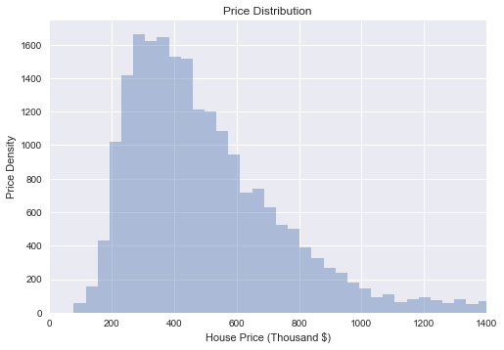
Price Distribution

Slide 3
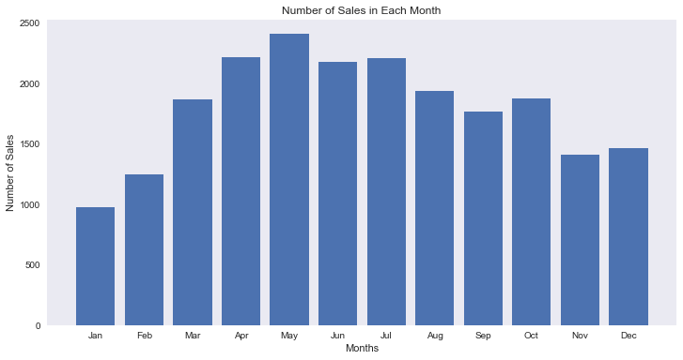
Number of Sales in Each Month

Slide 4
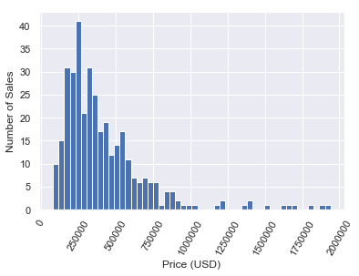
Duplicate Sales

Slide 5
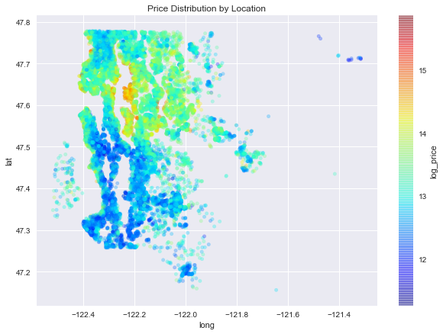
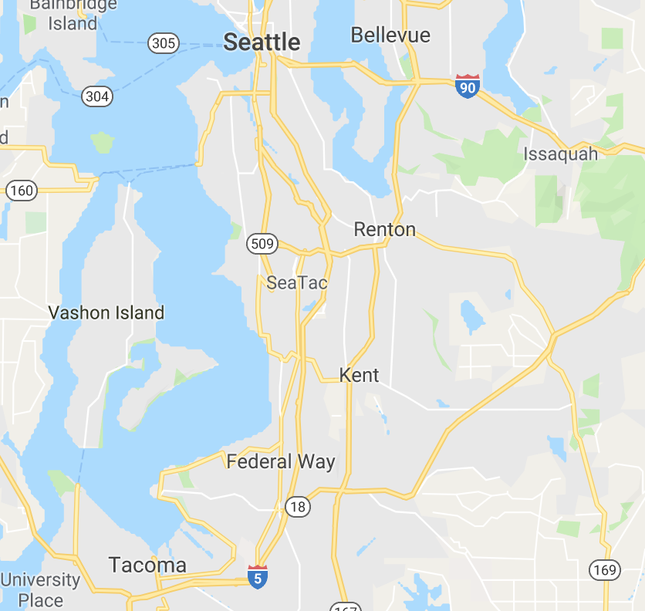
Comparing House Prices by Location
Price Distribution
KC Map

Slide 6
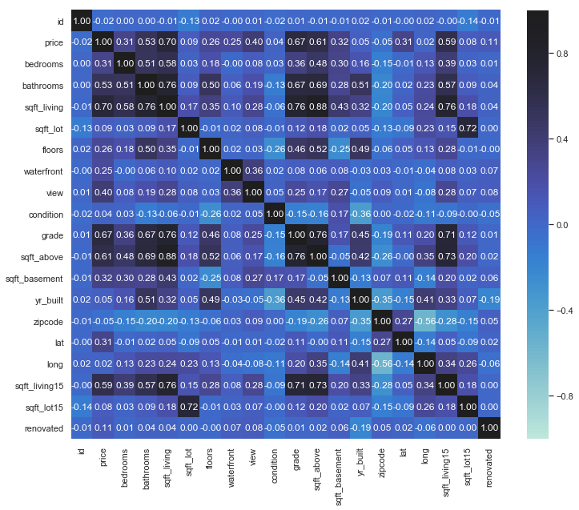
Relation Between Features

Slide 7
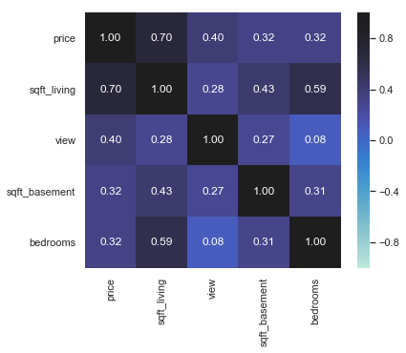
Model

Slide 8
Q&A

